Slide 1
Procedures

Slide 2
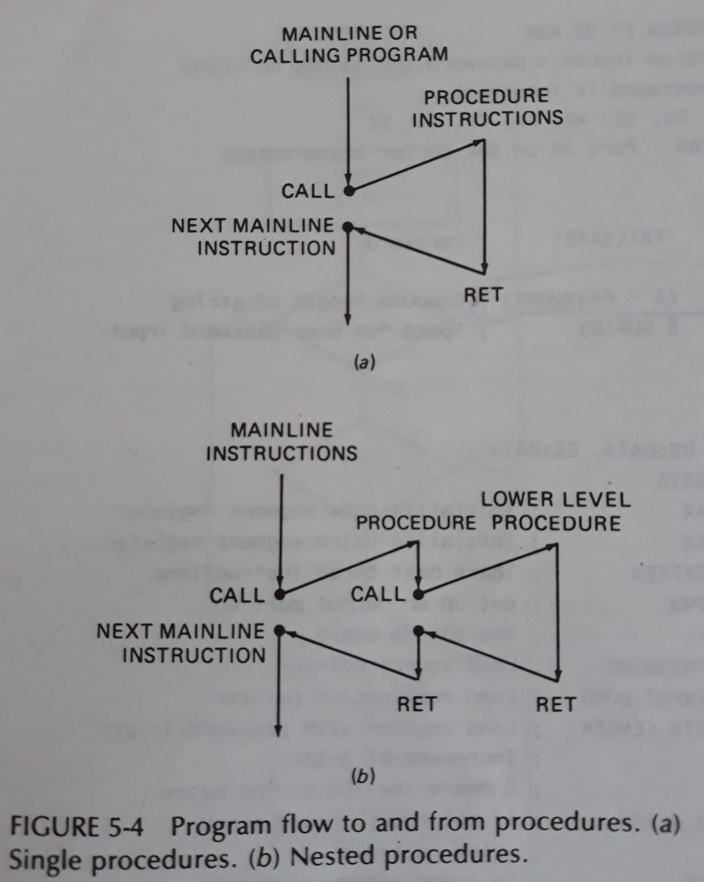

Slide 3
Classification of Procedures
Direct Within-Segment near call
Indirect Within-Segment near call
CALL BP
CALL WORD PTR[BX]
Direct inter-Segment Far call
Indirect inter-Segment Far call
Call DWORD PTR[BX]

Slide 4
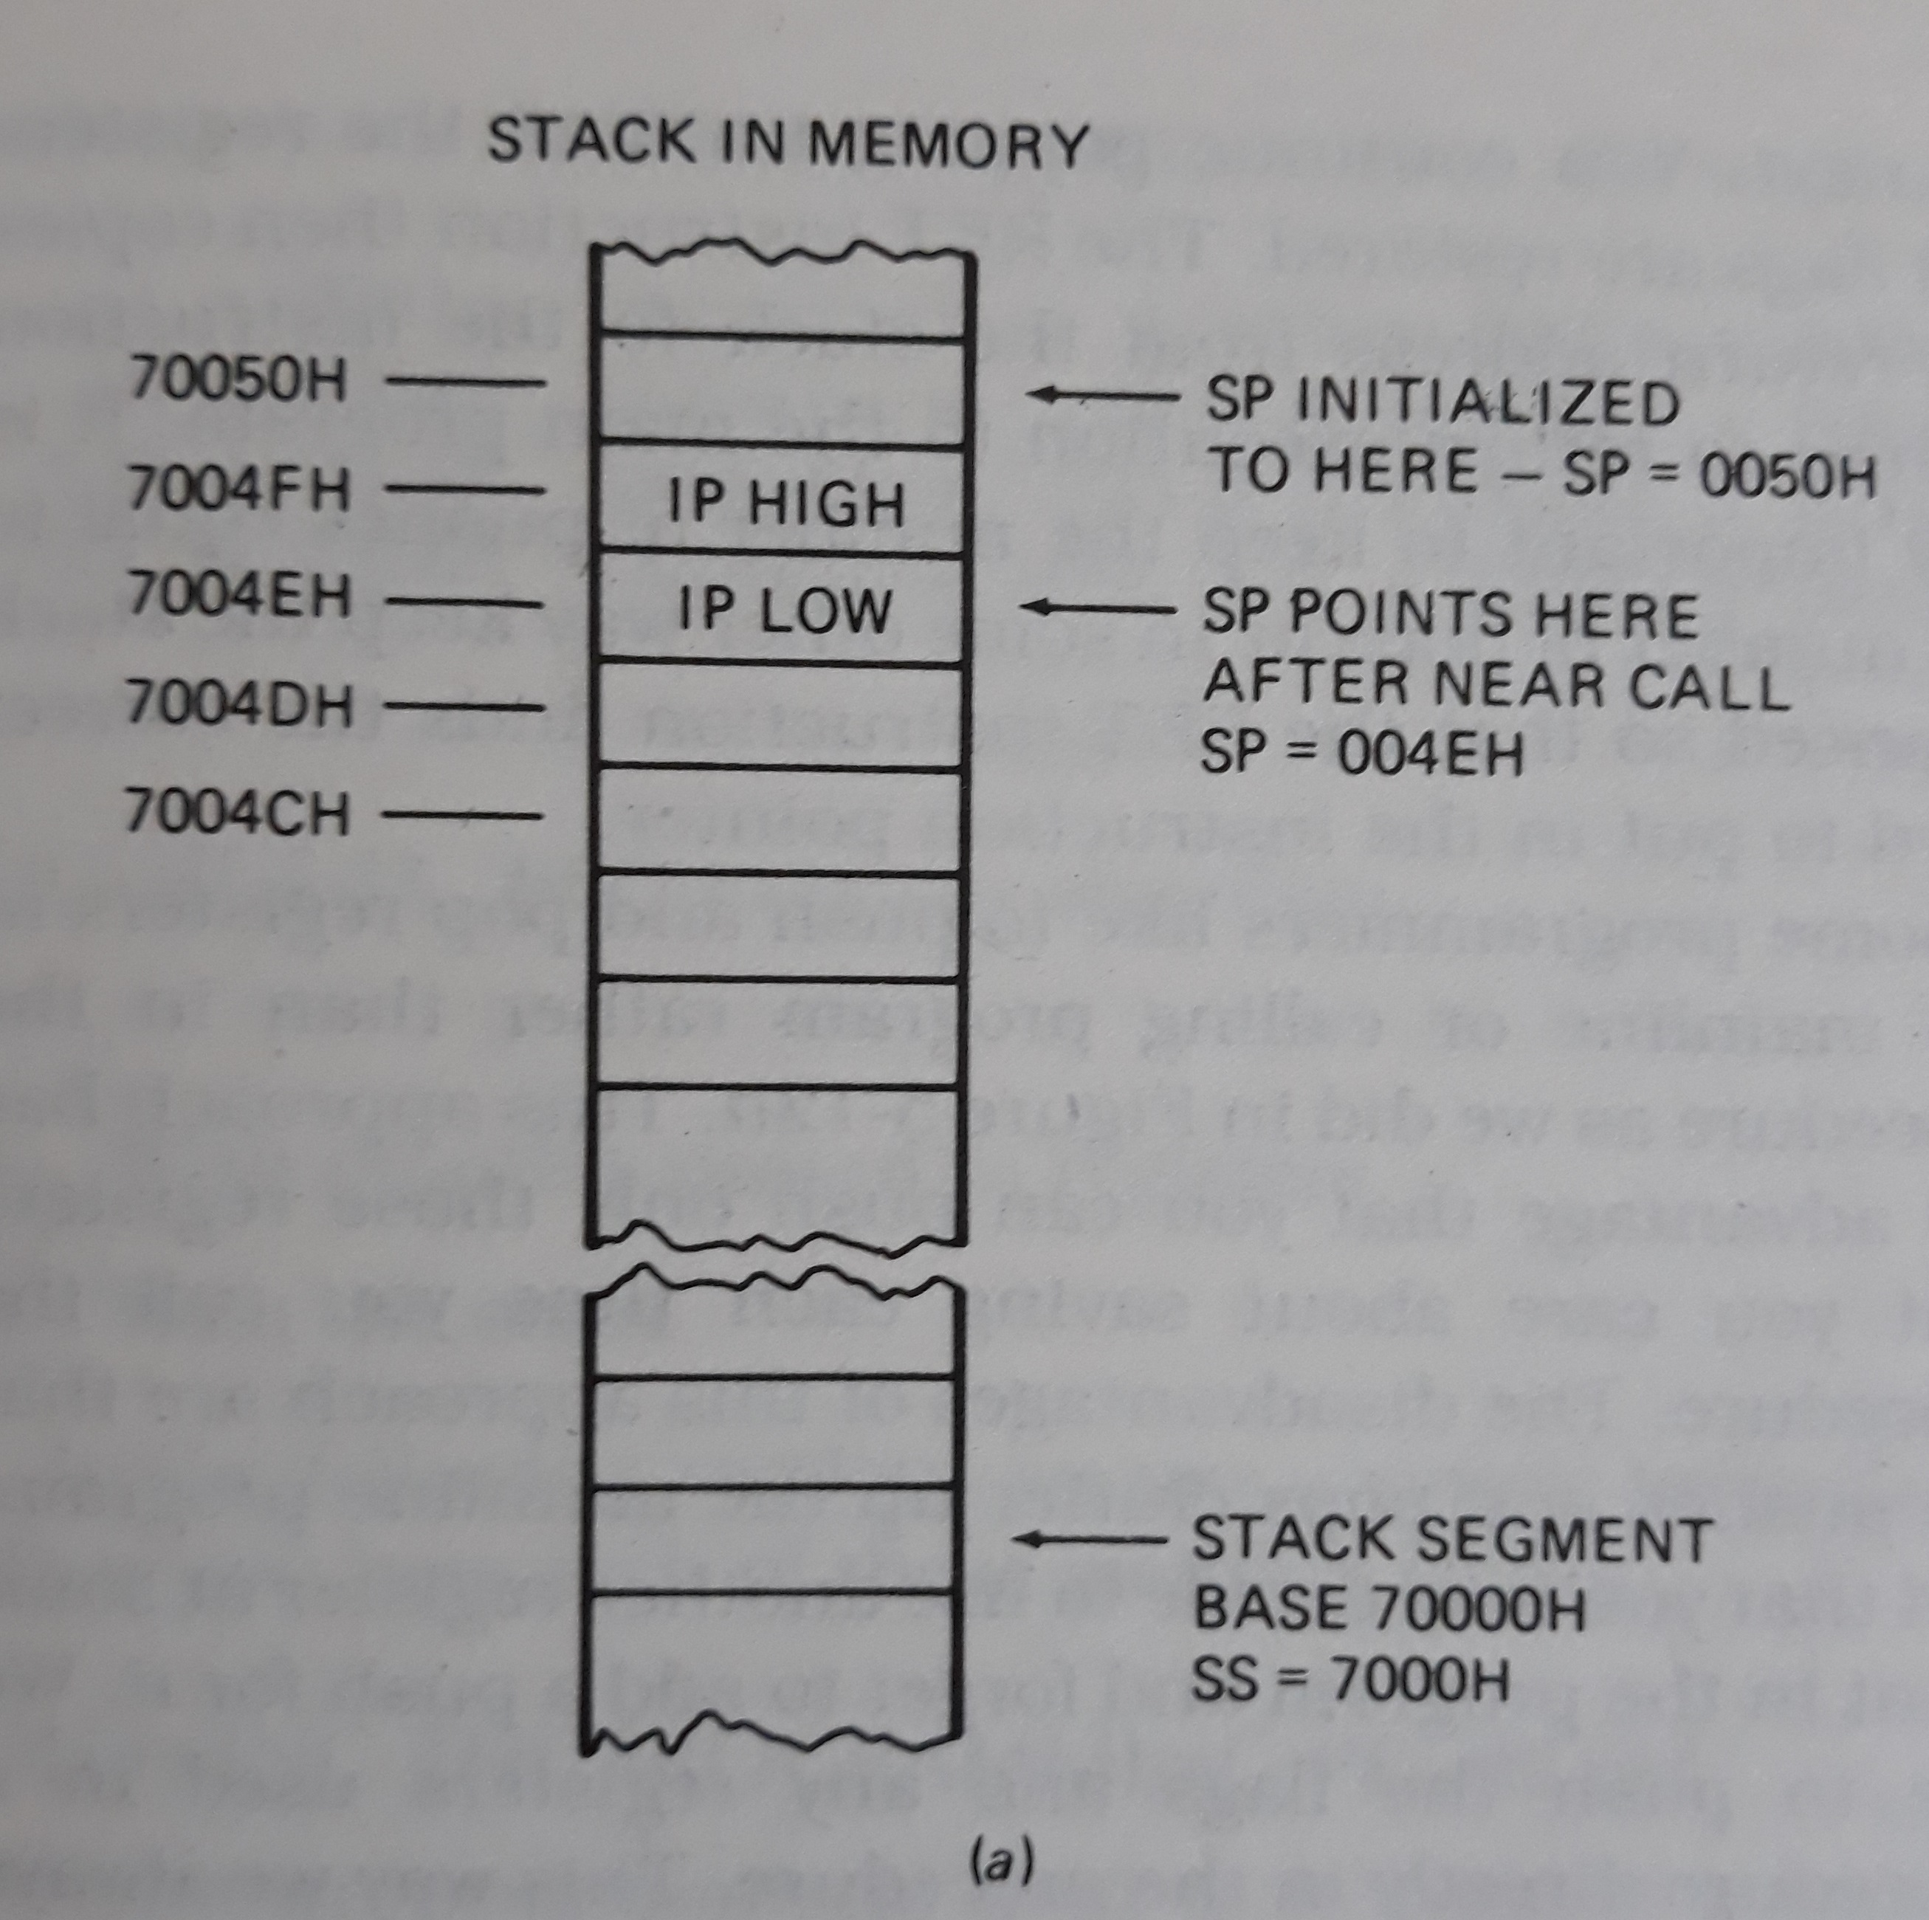
For Near CALL

Slide 5
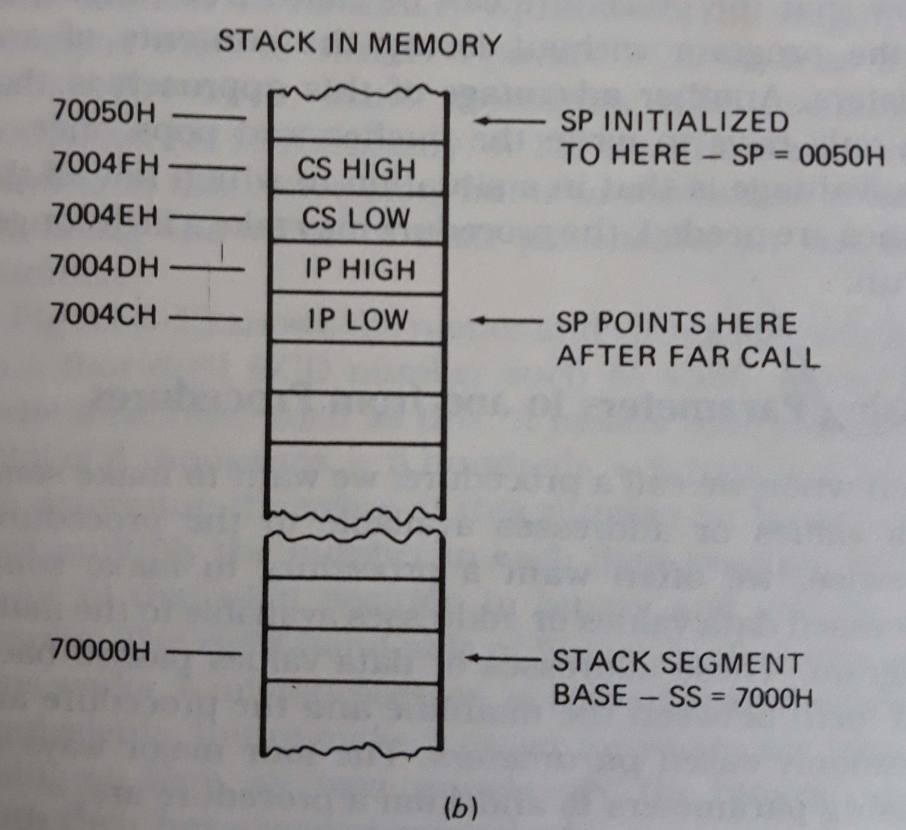
For Far CALL

Slide 6
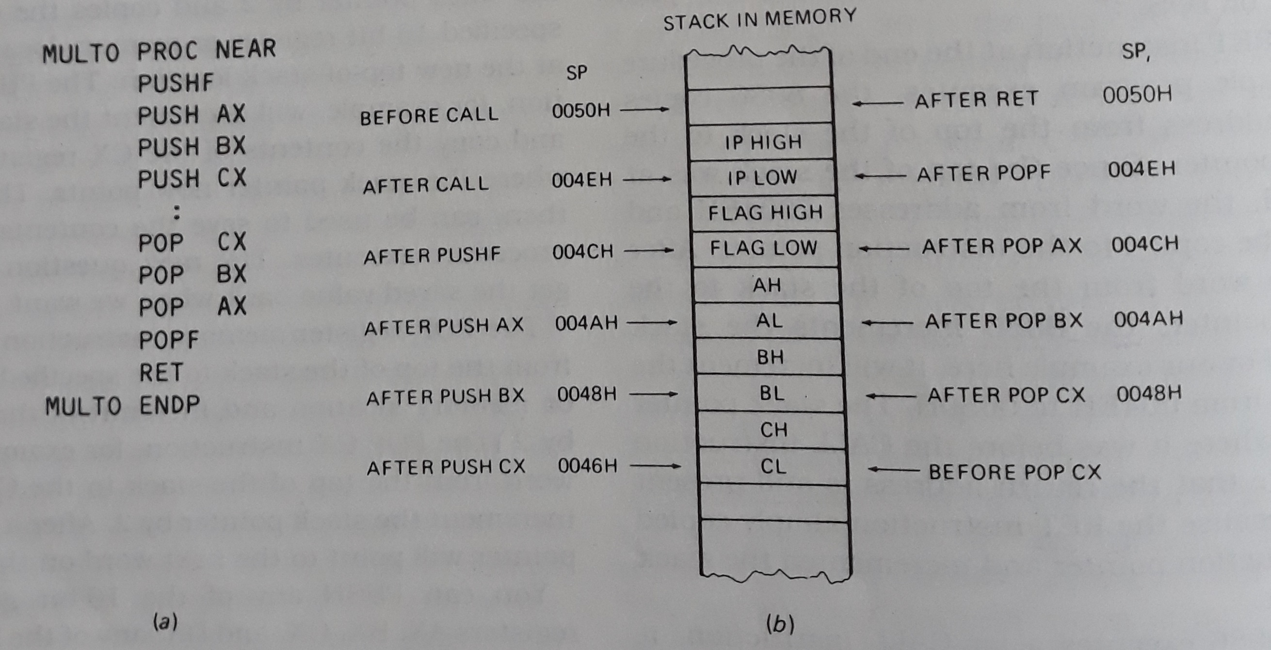
PUSH and POP instructions

Slide 7
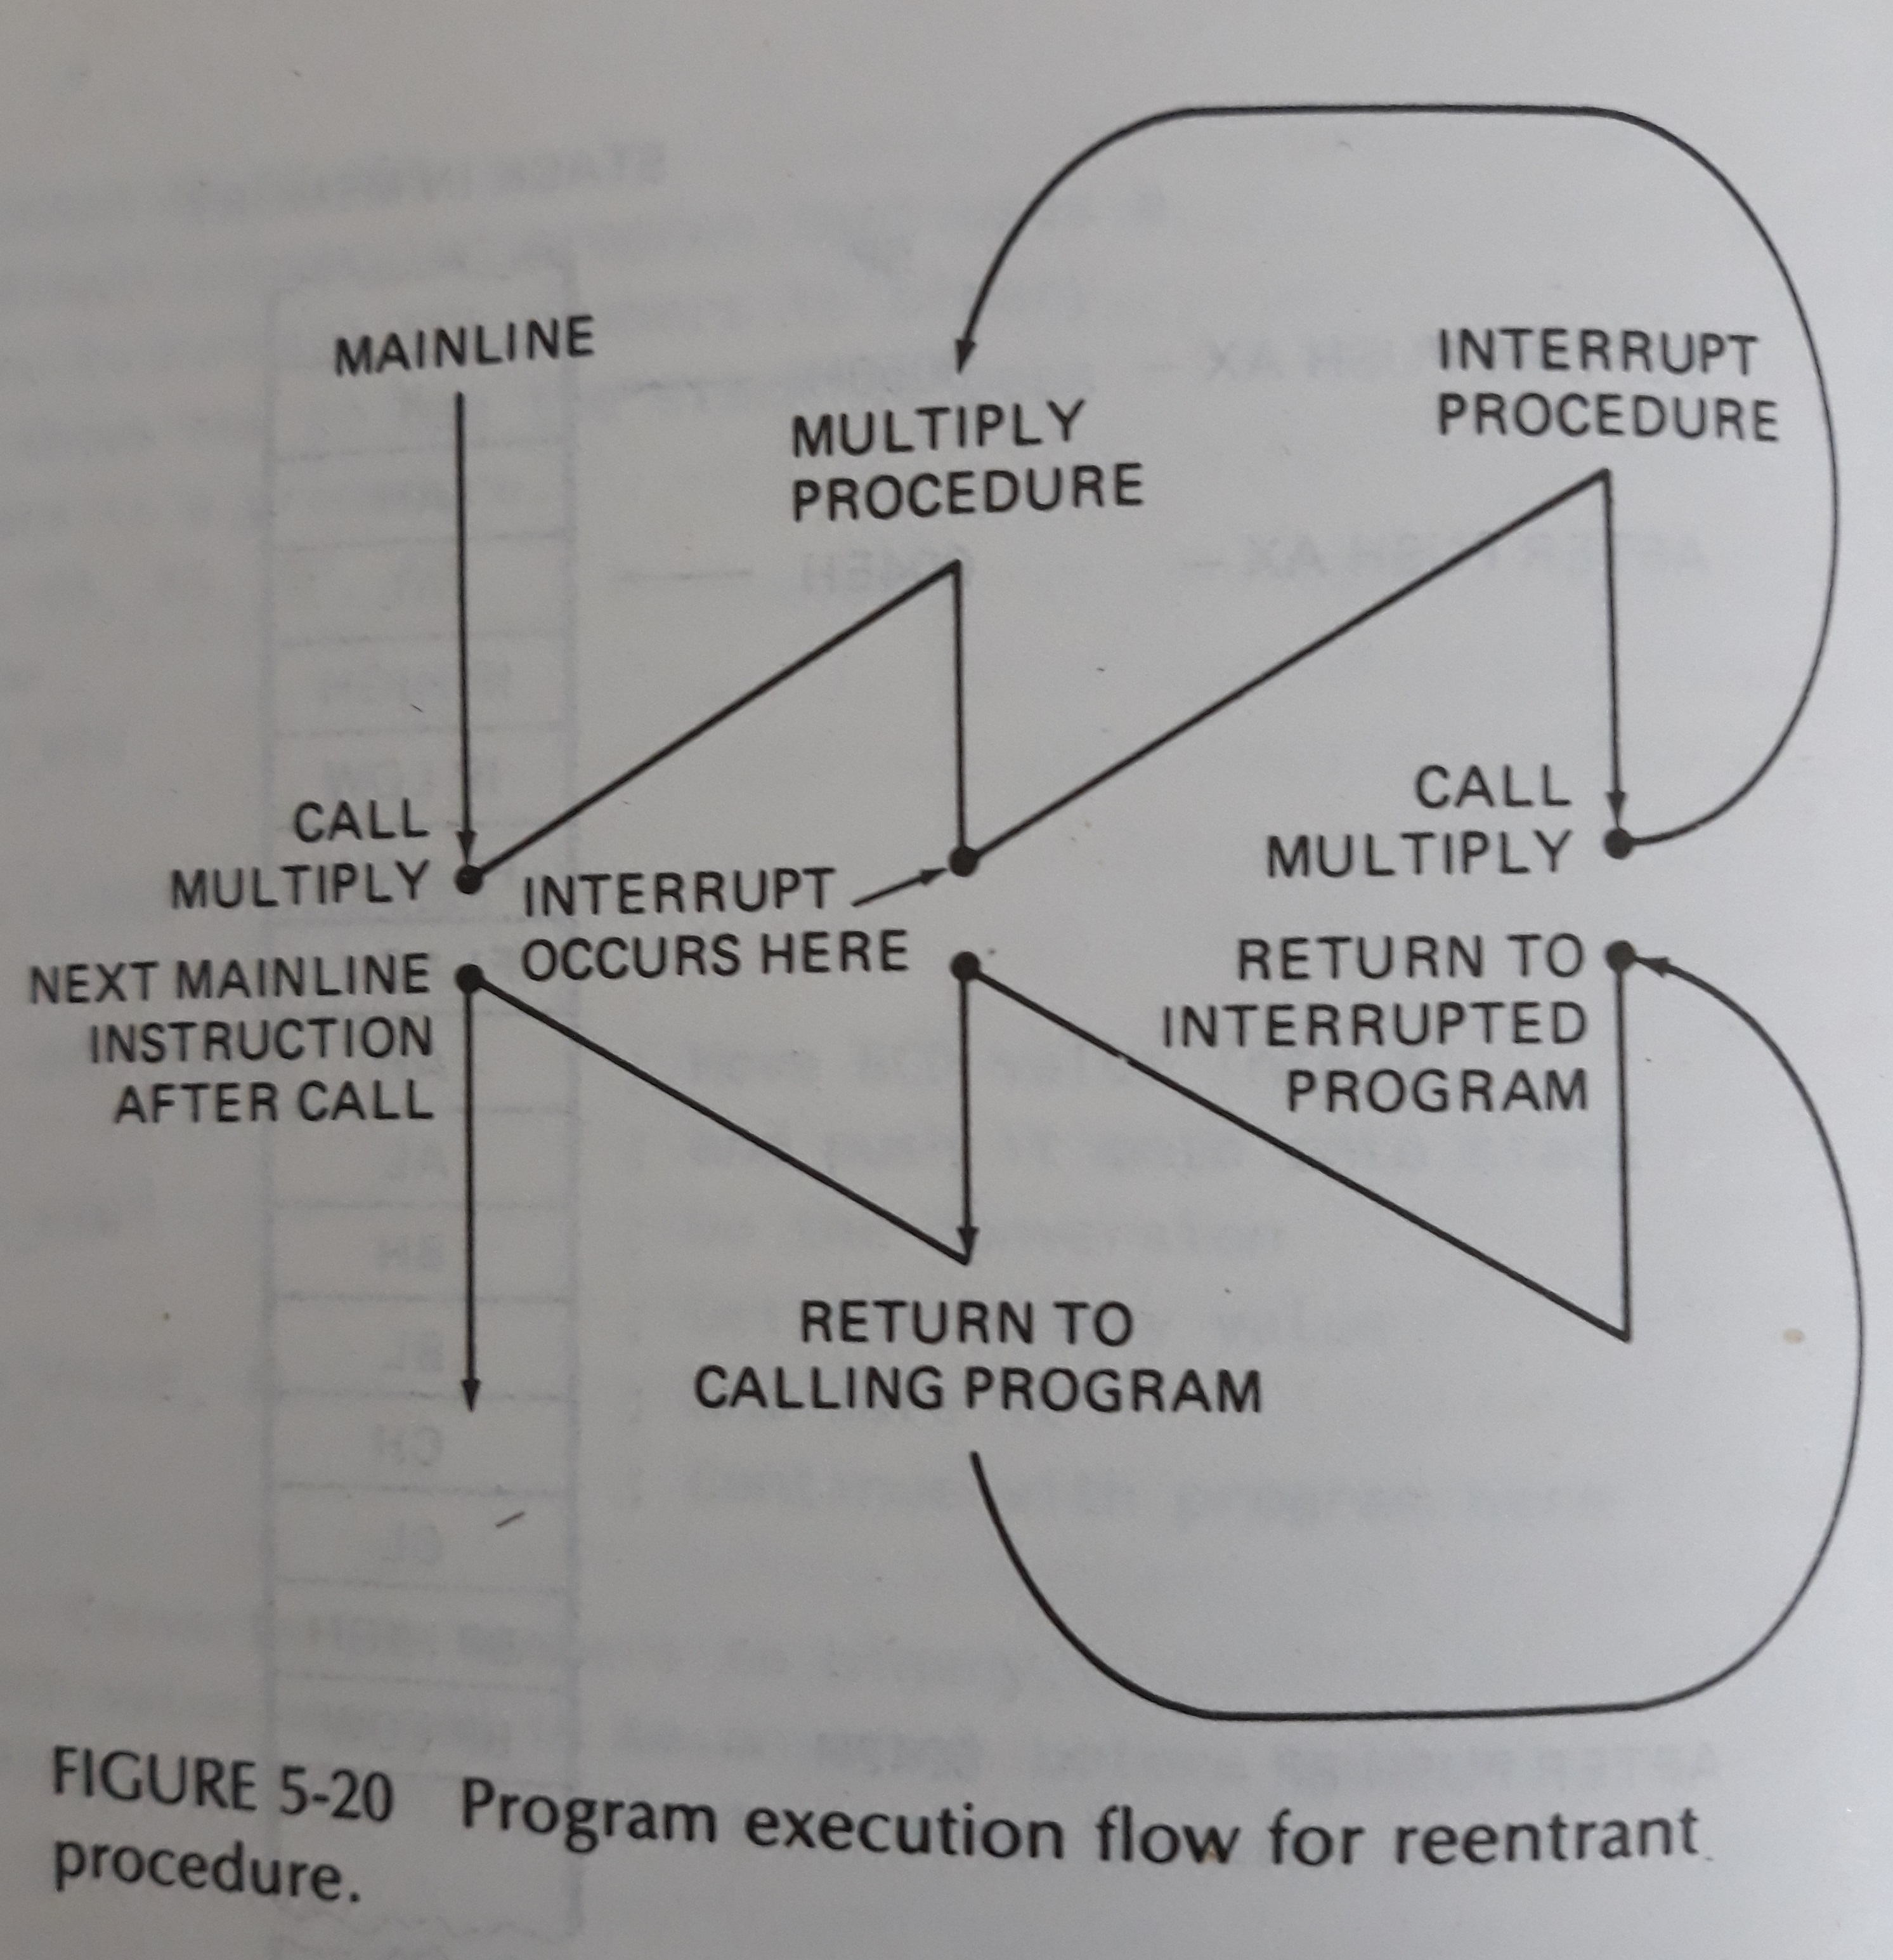
Reentrant Procedures

Slide 8
Recursive procedures
A recursive procedure is a procedures which call itself.
If N = 1 THEN factorial = 1
ELSE factorial = N * (factorial of N-1)

Slide 9
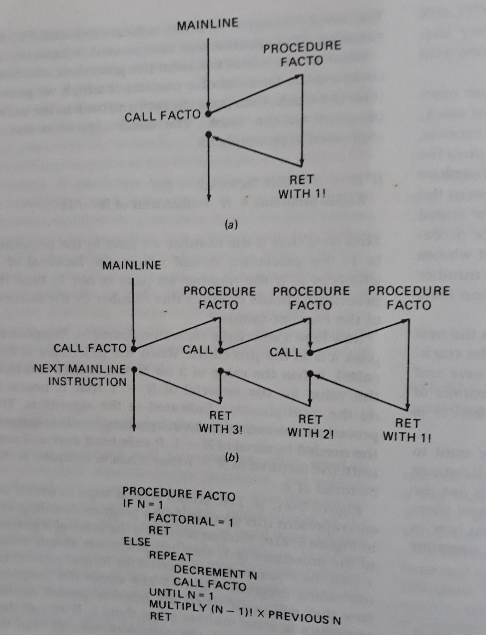

Slide 10
